Slide 1
Software Engineering 2UCCE501
Module 4

Slide 2
Module 4 System Implementation, Configuration Management & Risk Management
4.1 Packages & Interfaces: Distinguishing between classes versus interfaces. Exposing class & package interfaces.
4.2 Mapping Model to code, Mapping object models to Database schema.
4.3 Component & Deployment Diagrams: Describing dependencies.
4.4 Managing & Controlling Changes: Managing & Controlling versions.
4.5 Categories of Risks. Nature of risks, Types of risks, Risk identification, Risk assessment, Risk Planning and control, Risk Management, Evaluating risk to schedule, PERT technique.

Slide 3
Packages & Interfaces
Packages:
Organize related classes and interfaces into a single unit.
Declared using package keyword
Does not support multiple inheritance.
Group classes and interfaces based on functionality
Syntax: package com.software.mypackage;

Slide 4
Interfaces:
Define a contract for classes to implement
Declared using interface keyword.
Define method signatures that classes implementing the interface must provide implementations.
Interface methods are implicitly public and abstract.
Supports multiple inheritance as a class can implement multiple interfaces

Slide 5
Version Control
Challenges in distributed work environment:
Collaboration
Restoring previous version
What and where change happen
Backup
A version control system is a kind of software that helps the developer team to efficiently communicate and manage(track) all the changes that have been made to the source code along with the information like who made and what changes have been made.

Slide 6
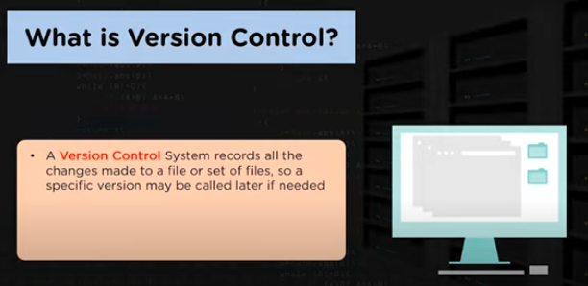
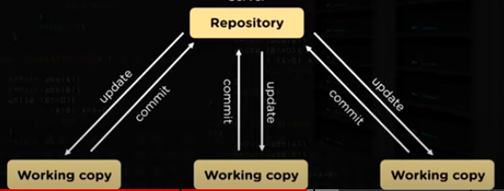

Slide 7
Version Control
Version control combines procedures and tools to manage different versions of configuration objects that are created during the software process.
A version control system implements four major capabilities:
(1) a project database that stores all relevant configuration objects
(2) a version management capability that stores all versions of a configuration object.
(3) a make facility that enables construct a specific version of the software.
(4) version control and change control systems often implement an issues tracking (also called bug tracking) capability

Slide 8
Version Control
A number of version control systems establish a change set—a collection of all changes that are required to create a specific version of the software.
named change sets can be identified for an application or system.
construct a version of the software by specifying the change sets (by name)

Slide 9
Version Control
Modeling approach for building new versions contains:
Template for building version
Construction rules
Verification rules

Slide 10
Change Control
It is a systematic approach to manage all changes made to the product.
Too much change control and we create problems.
large software project, uncontrolled change rapidly leads to chaos(confusion).
For large projects change control combines human procedures and automated tools to provide a mechanism for the control of change.

Slide 11
Change Control
engineering change order (ECO).
elements of change management:
Access Control
Access control governs which software engineers have the authority to access and modify a particular configuration object.

Slide 12
Change Control
2. Synchronization Control.
Synchronization control helps to ensure that parallel changes, performed by two different people, don’t overwrite one another.
Informal Change Control
Developer makes changes in project

Slide 13
Change Control
project level change control
developer must gain approval from the project manager to makes changes.
formal change control
is instituted when the software product is released to customers

Slide 14
